Slide 1
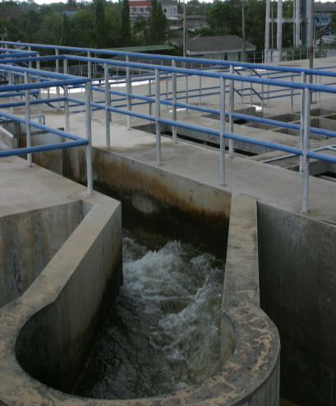
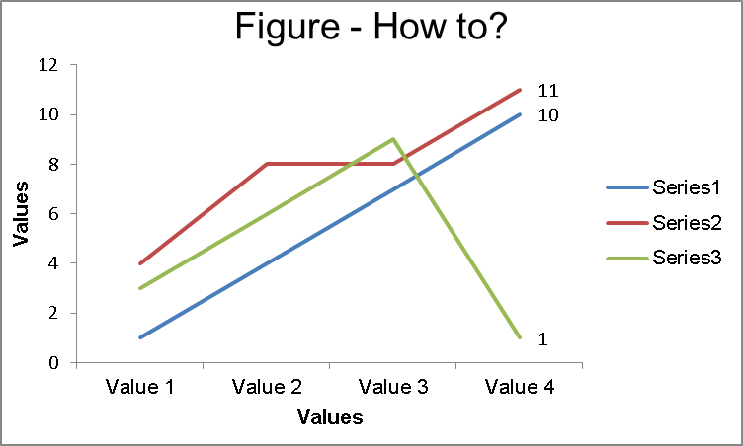
A poster template for the CentrEau research center
Add your photo here! (remove frame)
Author I Surname Name¹ , Author II Surname Name^{2,3} & Author III Surname Name¹
¹ CentrEau | Centre québécois de recherche sur la gestion de l’eau / Quebec’s Water Management Research Centre, 1065, Avenue de la Médecine, Québec (QC), G1V 0A6, Canada
² Enter the address of Institution 2 as given above
Introduction / Objective @ 52 pts
This example is to demonstrate the layout of an example poster for CentrEau. The purpose of a poster paper presentation is to promote informal discussion.
The poster presentation stands by itself as a summary of research and usually contains an overview of research objectives, experimental methods, materials, results and a discussion.
Often, in poster presentations, a clear message in less words is more effective.
Font should be Calibri.
The pictures are used to show key points of the research. You should use them but avoid resolution overkill, more than 150 dpi but less than 300 dpi.
Discussion @ 52 pts
Fill with text. Fill with text. Fill with text. Fill with text. Fill with text. Fill with text. Fill with text. Fill with text. Fill with text. Fill with text. Fill with text. Fill with text. Fill with text.
Fill with text. Fill with text. Fill with text. Fill with text.
Material & Methods @ 52 pts
The key message is: An interested individual who is not necessarily familiar with your field of expertise should be able to follow your poster.
The purpose of poster paper presentations is to promote informal discussion. To achieve your goal you’ll need to two things:
Conclusion @ 52pts
Reality
Modelling Environment
Modelling Environment
It should include a clear message (imagine a poster as an illustrated abstract).
An attractive and clear layout.
System
Experiment
Application
Application
Virtual Reality
Control Logic
Control Logic
Model
Virtual Experiment
Model Compiler
Model Compiler
Results @ 52 pts
This figure shows trends, it is light and easily understandable and self explanatory. The side box only gives some hints on what is in the figure.
High-Level Model
Executable Model
High-Level Model
Executable Model
TAKE-HOME MESSAGE @ 56 pts
Summaries your findings and list the key points of your research.
Be brief and direct. This shows the outcome of all of your efforts.
Use figures to support your text. Keep it short and simple. Text text text text text text text text text text text text text
Other logo
Other logo
Other logo
Author_email@university.ca
www.centreau.org

